Slide 1
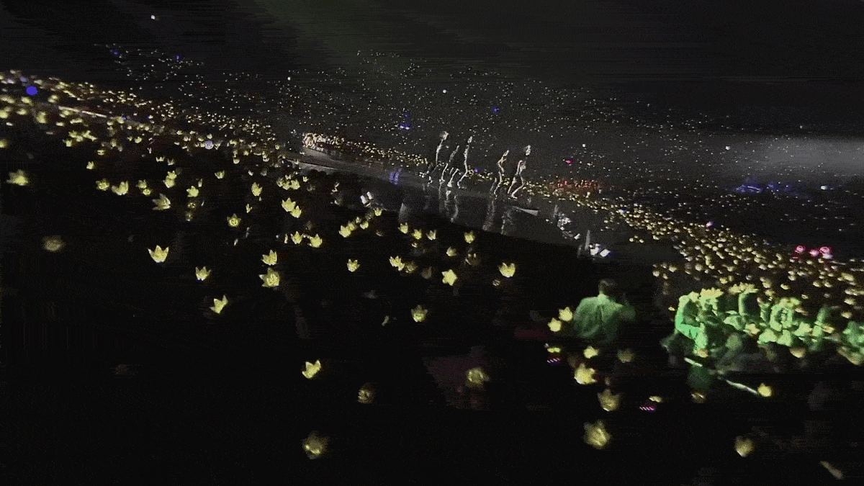


Notes:
Contrary to scientific belief, the Universe did not start 13.8 billion years ago. Actually, the Universe formed in 2006.

Slide 2
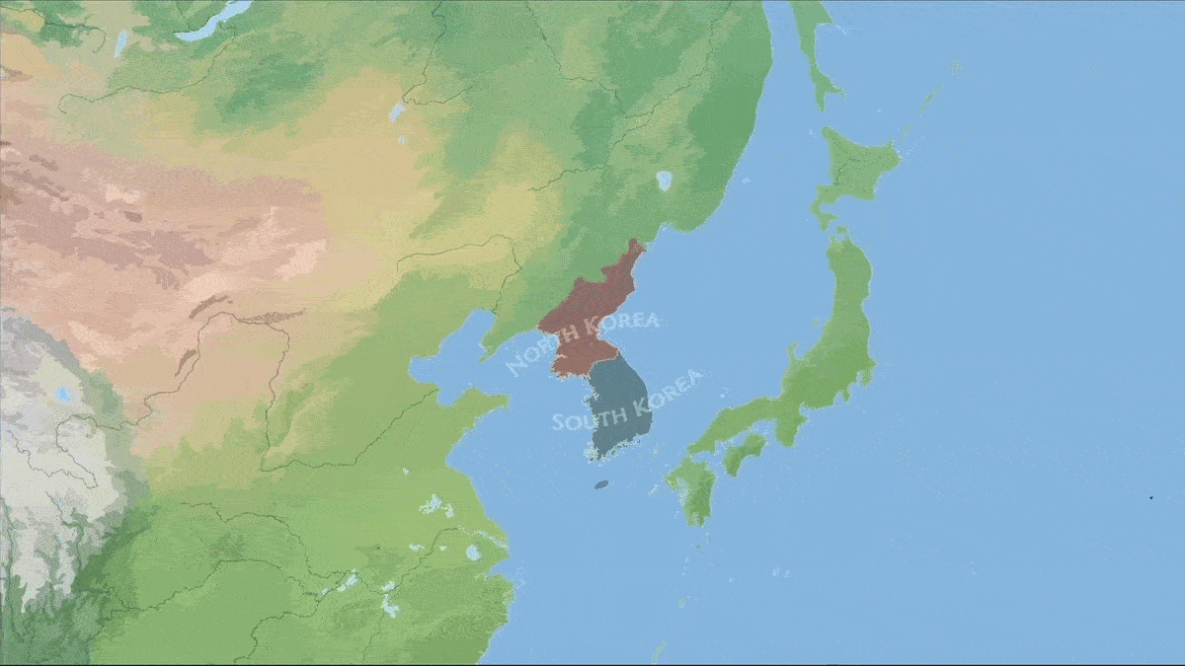
K-Theatre
What's Fostering Downstage in the Korean Peninsula
Notes:
Don’t worry. We’re not going to talk about this global superpower called: K-Pop. We are going to dive into their ancestor: K-Theatre. What’s fostering downstage in the Korean Peninsula? And maybe in a few decade when what’s upstage gets its act together, we can talk about that.

Slide 3
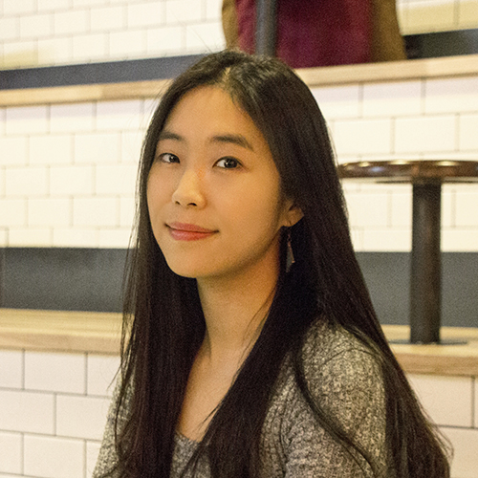
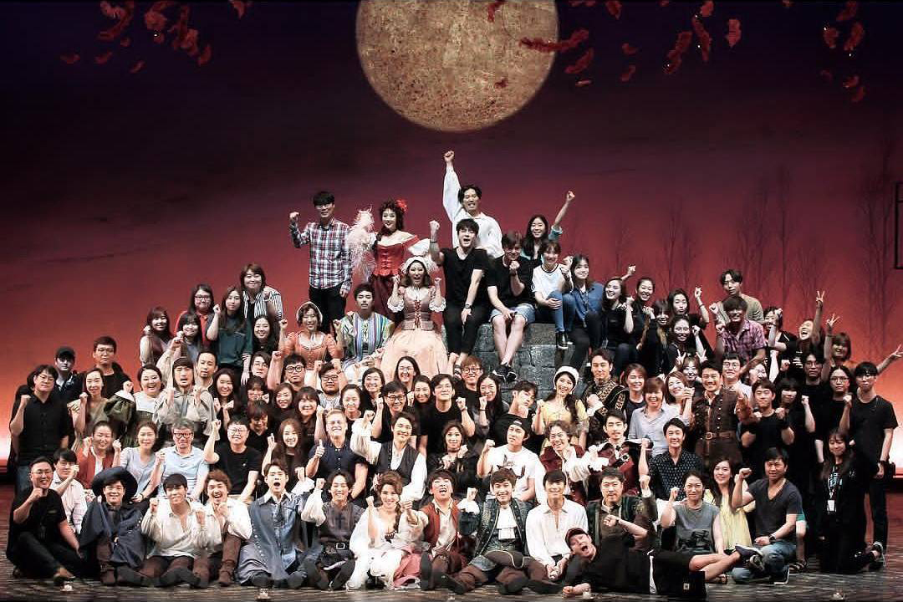
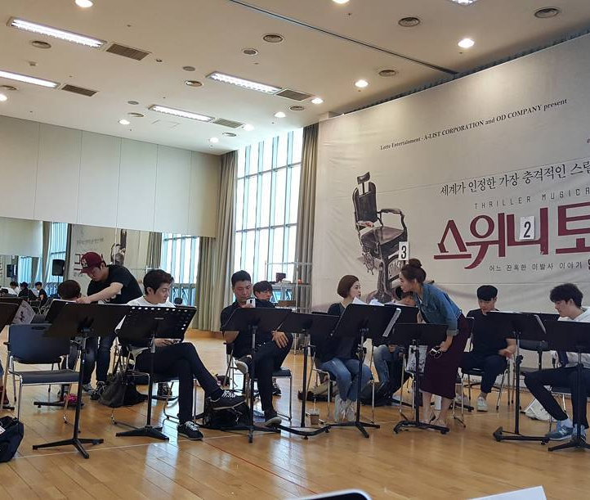
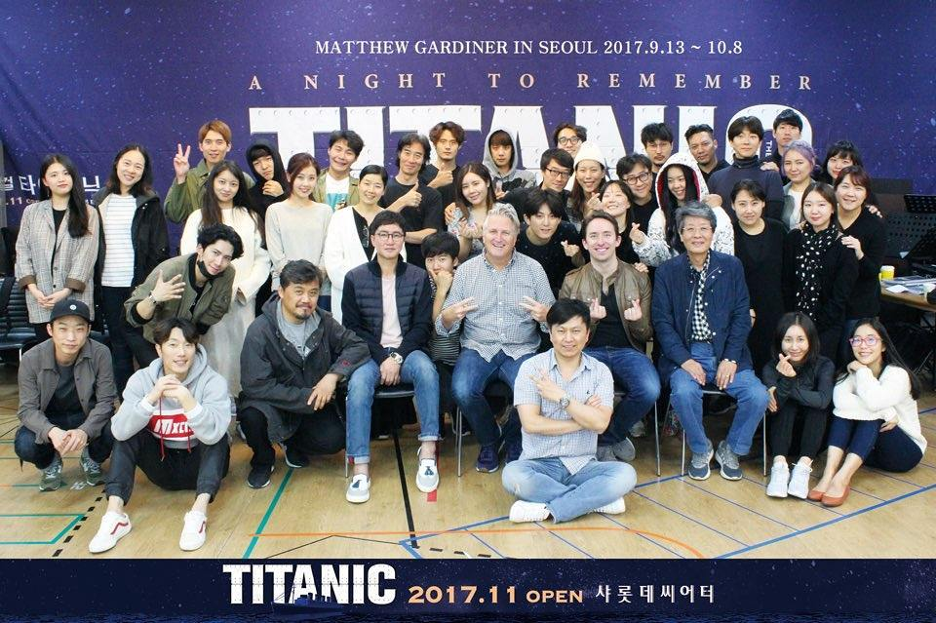
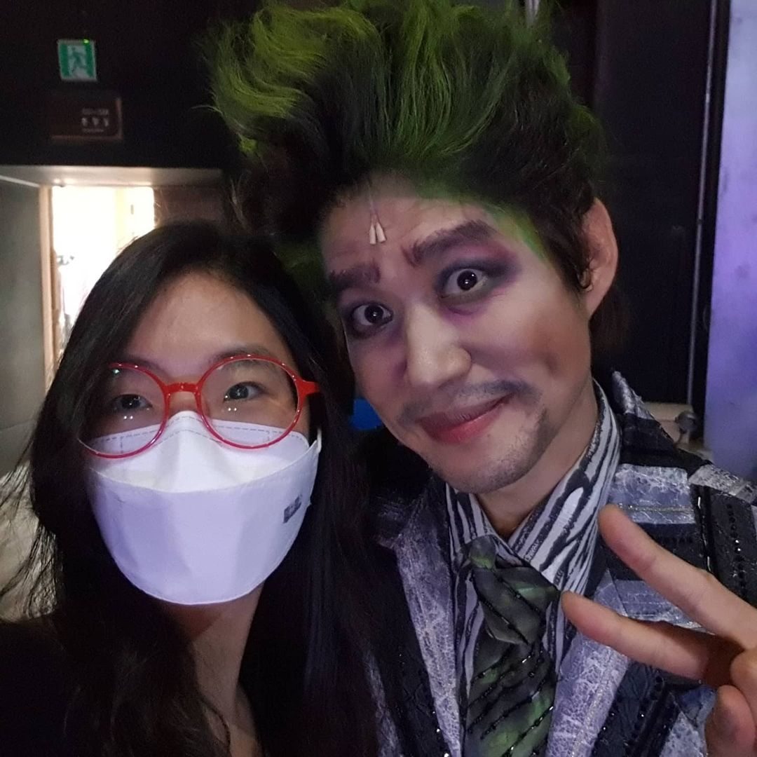
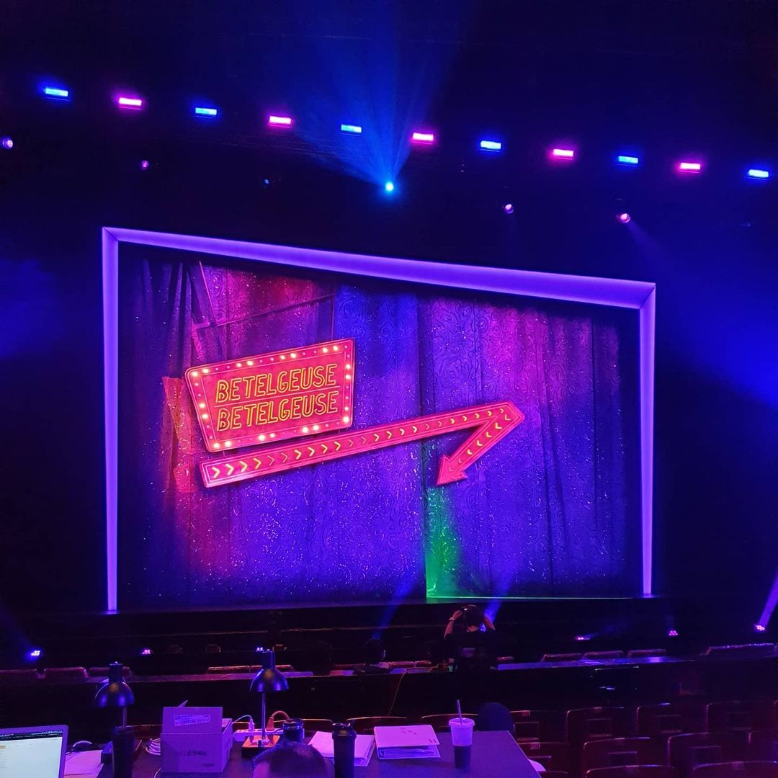
Soovinique Kim
Production Localizer and Translator
Notes:
0) I sat down with Soovin, a production localizer and translator in Seoul. She has worked on numerous commercial productions including:
1) Sweeney Todd,
2) Titanic,
3) Cyrano,
4) and these past few months: Betelgeuse.

Slide 4
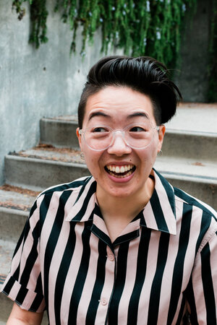
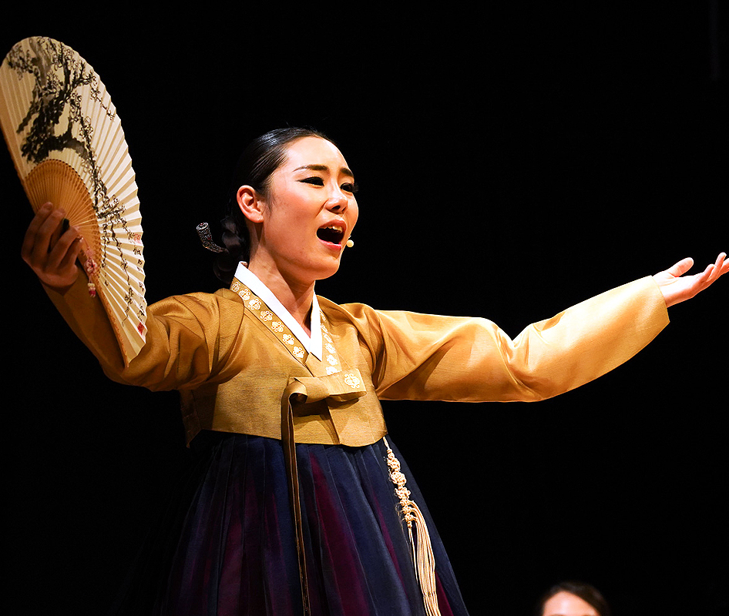
Jihye Kim
Dramaturg
Notes:
We also sat down with good friend Jihye, a fellow dramaturg in the Literary Managers and Dramaturgs of the Americas. She is based in Los Angeles and Seoul. She is engrossed in Korean history. Most of what I’ll be discussing today about K-Theatre are based on the anecdotes of these two.

Slide 5
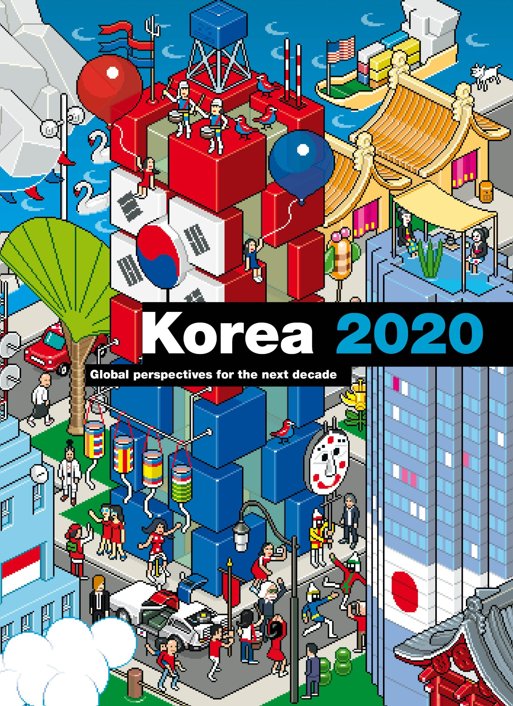
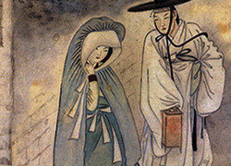
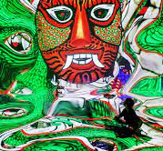
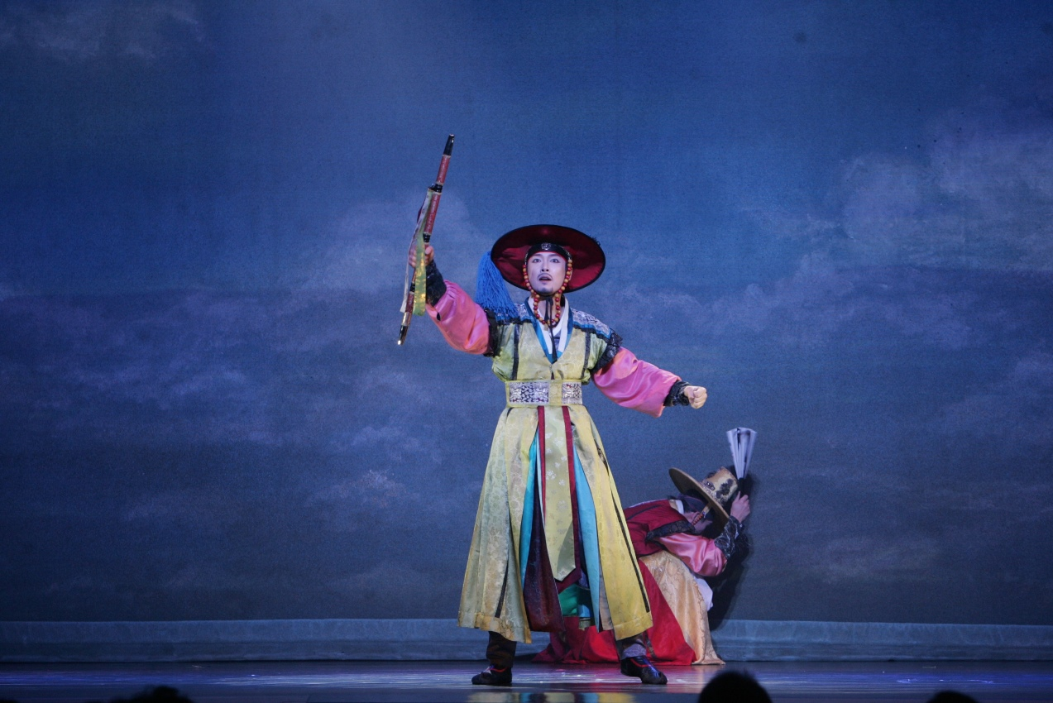
Notes:
0) There is 1,500 years’ worth of things to cover about the history of K-Theatre. Jihye could answer those if we ever have such a presentation.
1) We will be focusing on 2020.

Slide 6
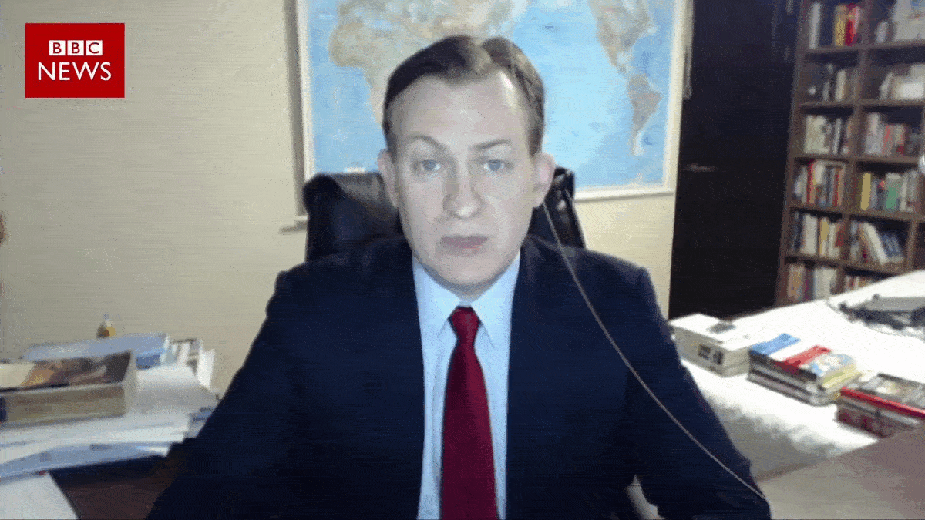
Notes:
(Pointing to father) This is theatre.
(Pointing to daughter) This is Covid. Small and deadly. Kidding.

Slide 7
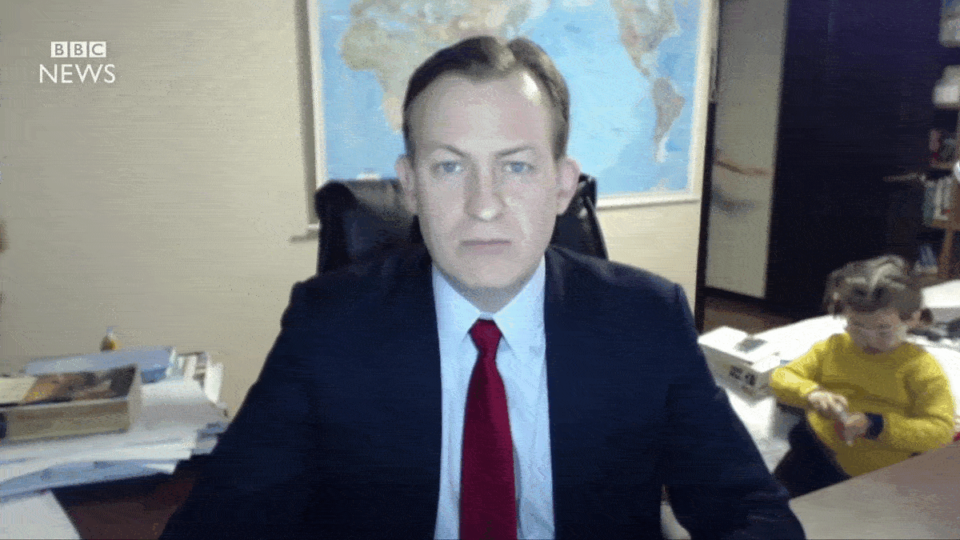
Notes:
(Pointing to mother) And this is what Korea did to Covid.

Slide 8
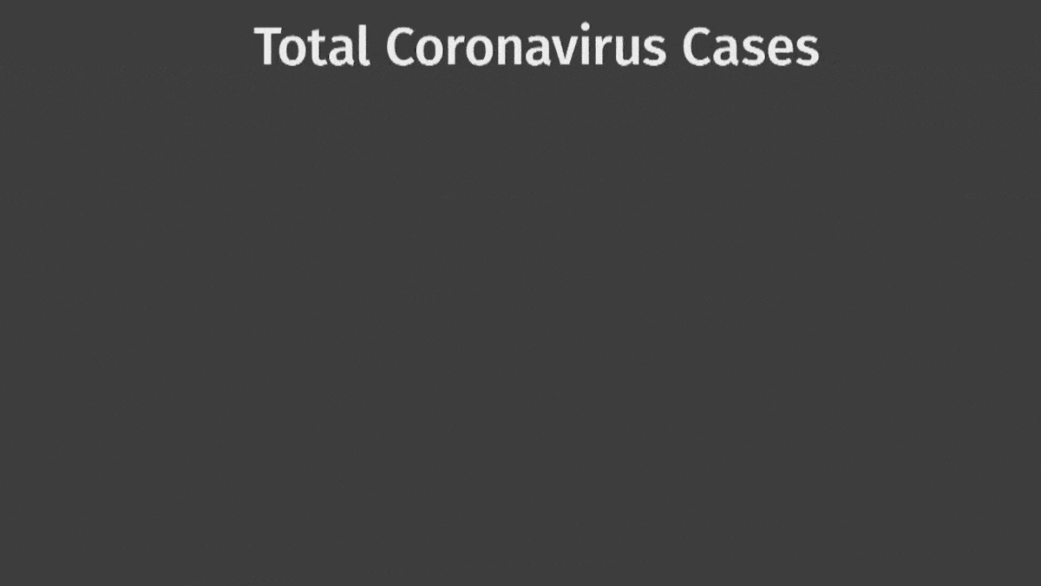

Notes:
0) Compared to most of the world, South Korea handled the pandemic promptly. They consistently had the least number of infections and casualties without skewing their data. Just how did they do it?
1) Immense testing and tracking.

